Slide 1
EECT 111-50C Lab Notebook
Circuit analysis
Spring 2015
Cody fletcher
May 7, 2015

Slide 2
TABLE OF CONTENTS
Lab 1 – Resistor Variability 3
Lab 2 – Reading and Sorting Resistors 7
Lab3 – Series Resistors Current and Voltage 11
Lab 4 – Black Box Design, Series Resistors 15
Lab 5 – Black Box Design, Parallel Resistors 19
Lab 6 – N/A
Lab 7 – Resistor Parallel Circuit 27
Lab 8 –Black Box Design, Equal Value Resistors 31
Lab 9 – Series/Parallel Resistors 35
Lab 10 –Series/Parallel Capacitors 39
Lab 11 – RC Lab 43
Lab 12 – Series/Parallel Inductors 47

Slide 3
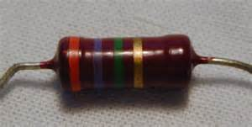
Lab 1 – Resistor Variability

Slide 4
Lab 1 – Resistor Variability
Purpose:
Learn the how resistors vary using 20 resistors with the same color code. Select a set of 20 1 kohm resistors. Measure and record the resistance of each resistor.
Equipment Used:
Digital Multimeter: Gwinstck GDM8245 CL860264
20 Resistors with the same color code/value

Slide 5
Lab 1 – Resistor Variability
Calculations, Simulations, Measurements
 | Series 1 | Series 2 | Series 3 | Series 4
sample | measured Ω | low tolerance | hi tolerance | nominal
1 | 980 | 950 | 1050 | 1000
2 | 984 | 950 | 1050 | 1000
3 | 981 | 950 | 1050 | 1000
4 | 982 | 950 | 1050 | 1000
5 | 984 | 950 | 1050 | 1000
6 | 982 | 950 | 1050 | 1000
7 | 984 | 950 | 1050 | 1000
8 | 980 | 950 | 1050 | 1000
9 | 987 | 950 | 1050 | 1000
10 | 981 | 950 | 1050 | 1000

Slide 6
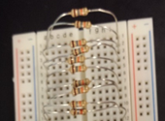
Lab 1 – Resistor Variability

Slide 7
Lab 1 – Resistor Variability
Conclusions
All resistors where within tolerance

Slide 8
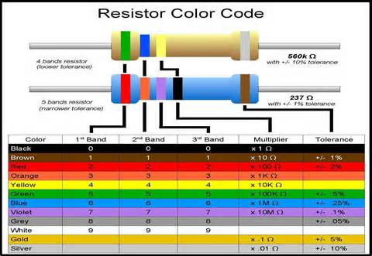
Lab 2 – Reading and Sorting Resistors

Slide 9
Lab 2 – Reading and Sorting Resistors
Purpose:
Learn the resistor color code using 15 resistors which must be sorted from smallest to largest value. Build a resistor kit that includes 15 resistors and, sort resistors based on color code from smallest to largest and measure the resistance of each resistor and verify sorting
Equipment Used:
Digital Multimeter: Gwinstck GDM8245 CL860264
15 unique resistors

Slide 10
Lab 2 – Reading and Sorting Resistors
Calculations, Simulations, Measurements

Slide 11
Lab 2 – Reading and Sorting Resistors
Conclusions
All resistors where within tolerance
Measured value was consistent with color code

Slide 12
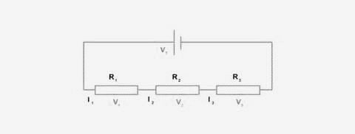
Lab3 – Series Resistors Current and Voltage

Slide 13
Lab3 – Series Resistors Current and Voltage
Purpose:
Experiment with series circuits and verify that the simulation, analysis (calculations) and test results all agree.
Equipment Used:
Digital Multimeter: Gwinstck GDM8245 CL860264
Elvis II
3 ea Resistors (10K, 2.2K, 4.7K)

Slide 14
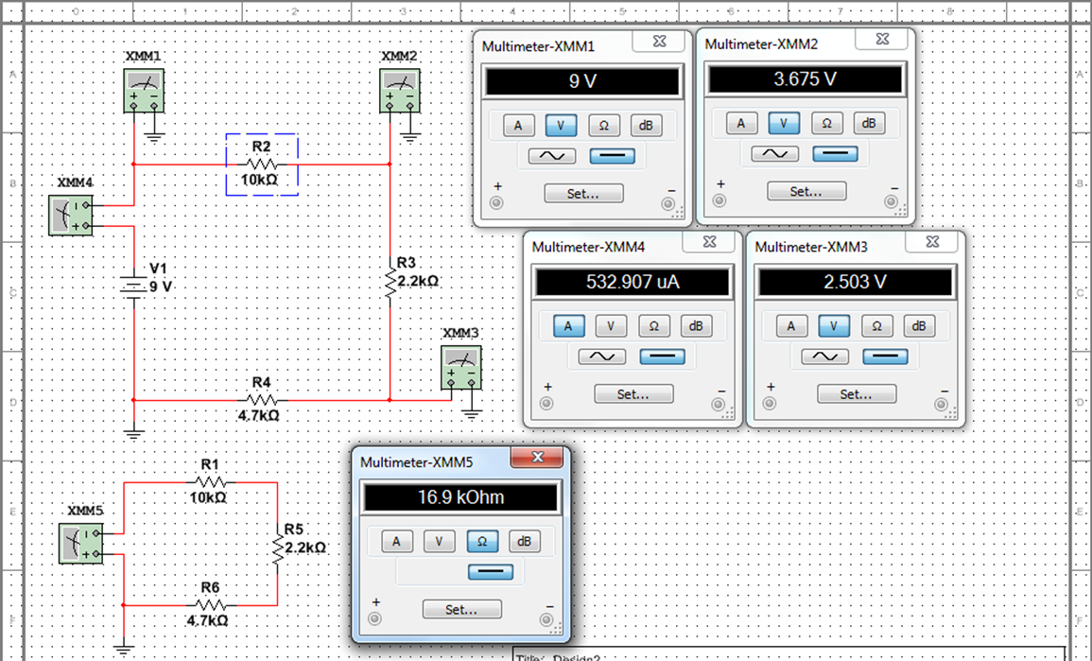
Lab3 – Series Resistors Current and Voltage
Calculations, Simulations, Measurements
 | Calculated |  | Measured |  | Simulated
IT | 532.5E-6 | A | 541.3E-6 | A | 532.907 | μA
V1 | 9 | V | 9.019 | V | 9 | V
VA | 5.325443787 | V | 5.315 | V | 5.325 | V
VB | 1.171597633 | V | 1.16 | V | 1.172 | V
VC | 2.50295858 | V | 2.529 | V | 2.503 | V
R₁ | 10.0E+3 | Ω | 9.8E+3 | Ω | 1.00E+03 | Ω
R₂ | 2.2E+3 | Ω | 2.2E+3 | Ω | 2.20E+03 | Ω
R₃ | 4.7E+3 | Ω | 4.6E+3 | Ω | 4.70E+03 | Ω
R_{T} | 16.9E+3 | Ω | 16.6E+3 | Ω | 16.9E+3 | Ω

Slide 15
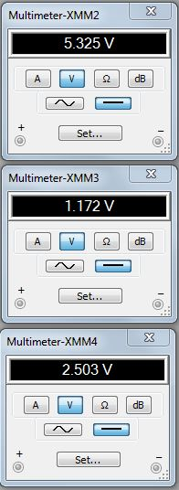
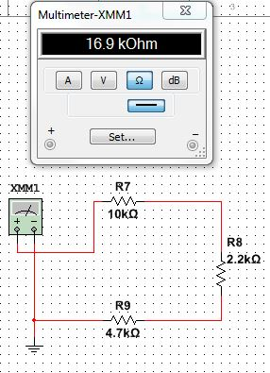
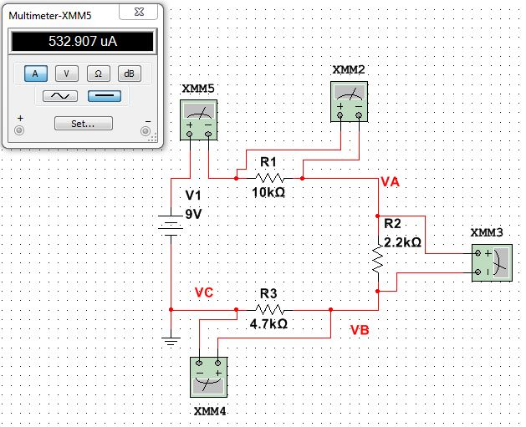
Lab 3
Voltage Drops
Simulations:
Total Current
Total Resistance

Slide 16
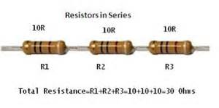
Lab 4 – Black Box Design, Series Resistors

Slide 17
Lab 4 – Black Box Design, Series Resistors
Purpose:
Experiment with series circuits and verify the simulation, analysis (calculations)
and test results all agree.
Equipment used:
Digital Multimeter: Gwinstck GDM8245 CL860264
Elvis II
Resistors

Slide 18
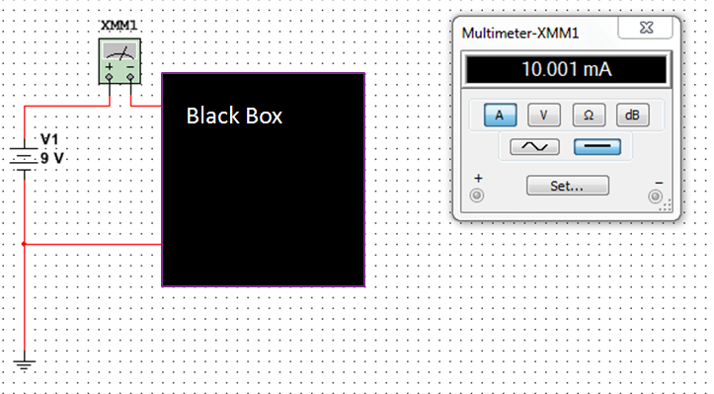
Lab 4 – Black Box Design, Series Resistors
Calculations, Simulations, Measurements

Slide 19
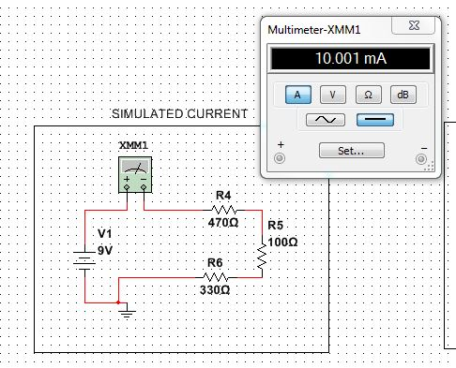
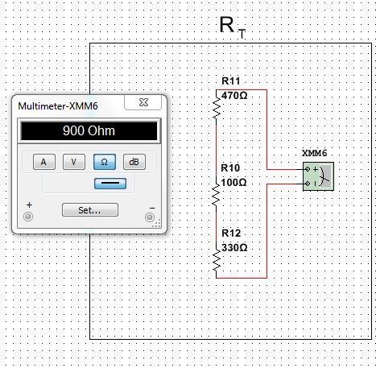
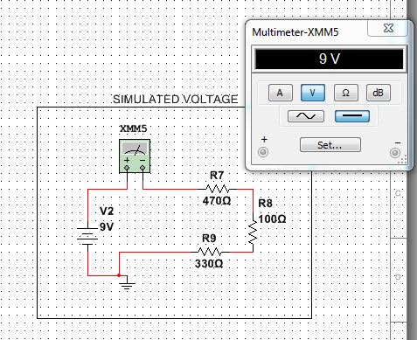
Lab 4
Simulations:
R1
R1
R2
R2
R3
R3

Slide 20
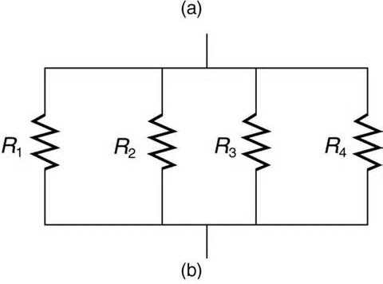
Lab 5 – Black Box Design, Parallel Resistors

Slide 21
Lab 5 – Black Box Design, Parallel Resistors
Purpose:
Learn about parallel circuits
Equipment Used:
Digital Multimeter: Gwinstck GDM8245 CL860264
Elvis II
Standard Resistors

Slide 22
Lab 5 – Black Box Design, Parallel Resistors
Calculations, Simulations, Measurements

Slide 23
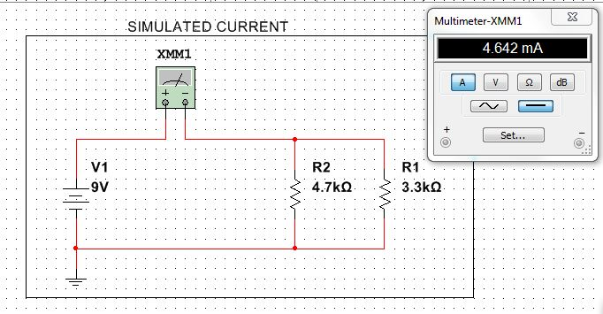
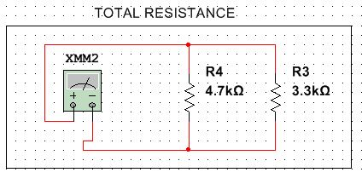
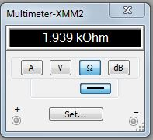
Lab 5
Simulations:
2 Resistor Circuit
R2
R1

Slide 24
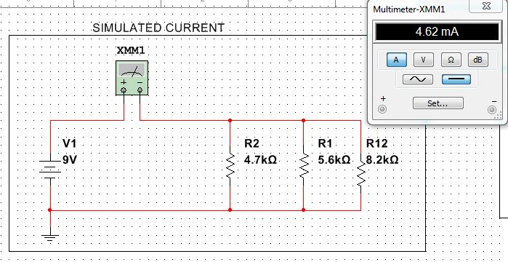
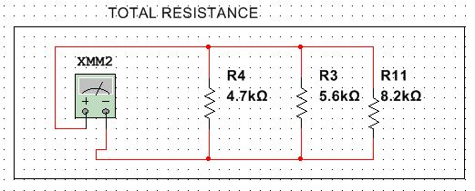
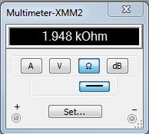
Lab 5
Simulations:
3 Resistor Circuit
R1
R2
R3
R1
R2
R3

Slide 25

Lab 7 – Resistor Parallel Circuit

Slide 26
Lab 7 – Resistor Parallel Circuit
Purpose:
Learn about Parallel circuits.
Equipment used:
Digital Multimeter: Gwinstck GDM8245 CL860264
Elvis II
Standard Resistors

Slide 27
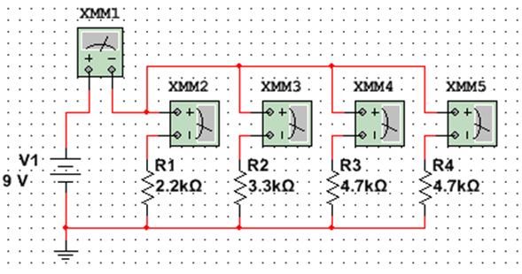
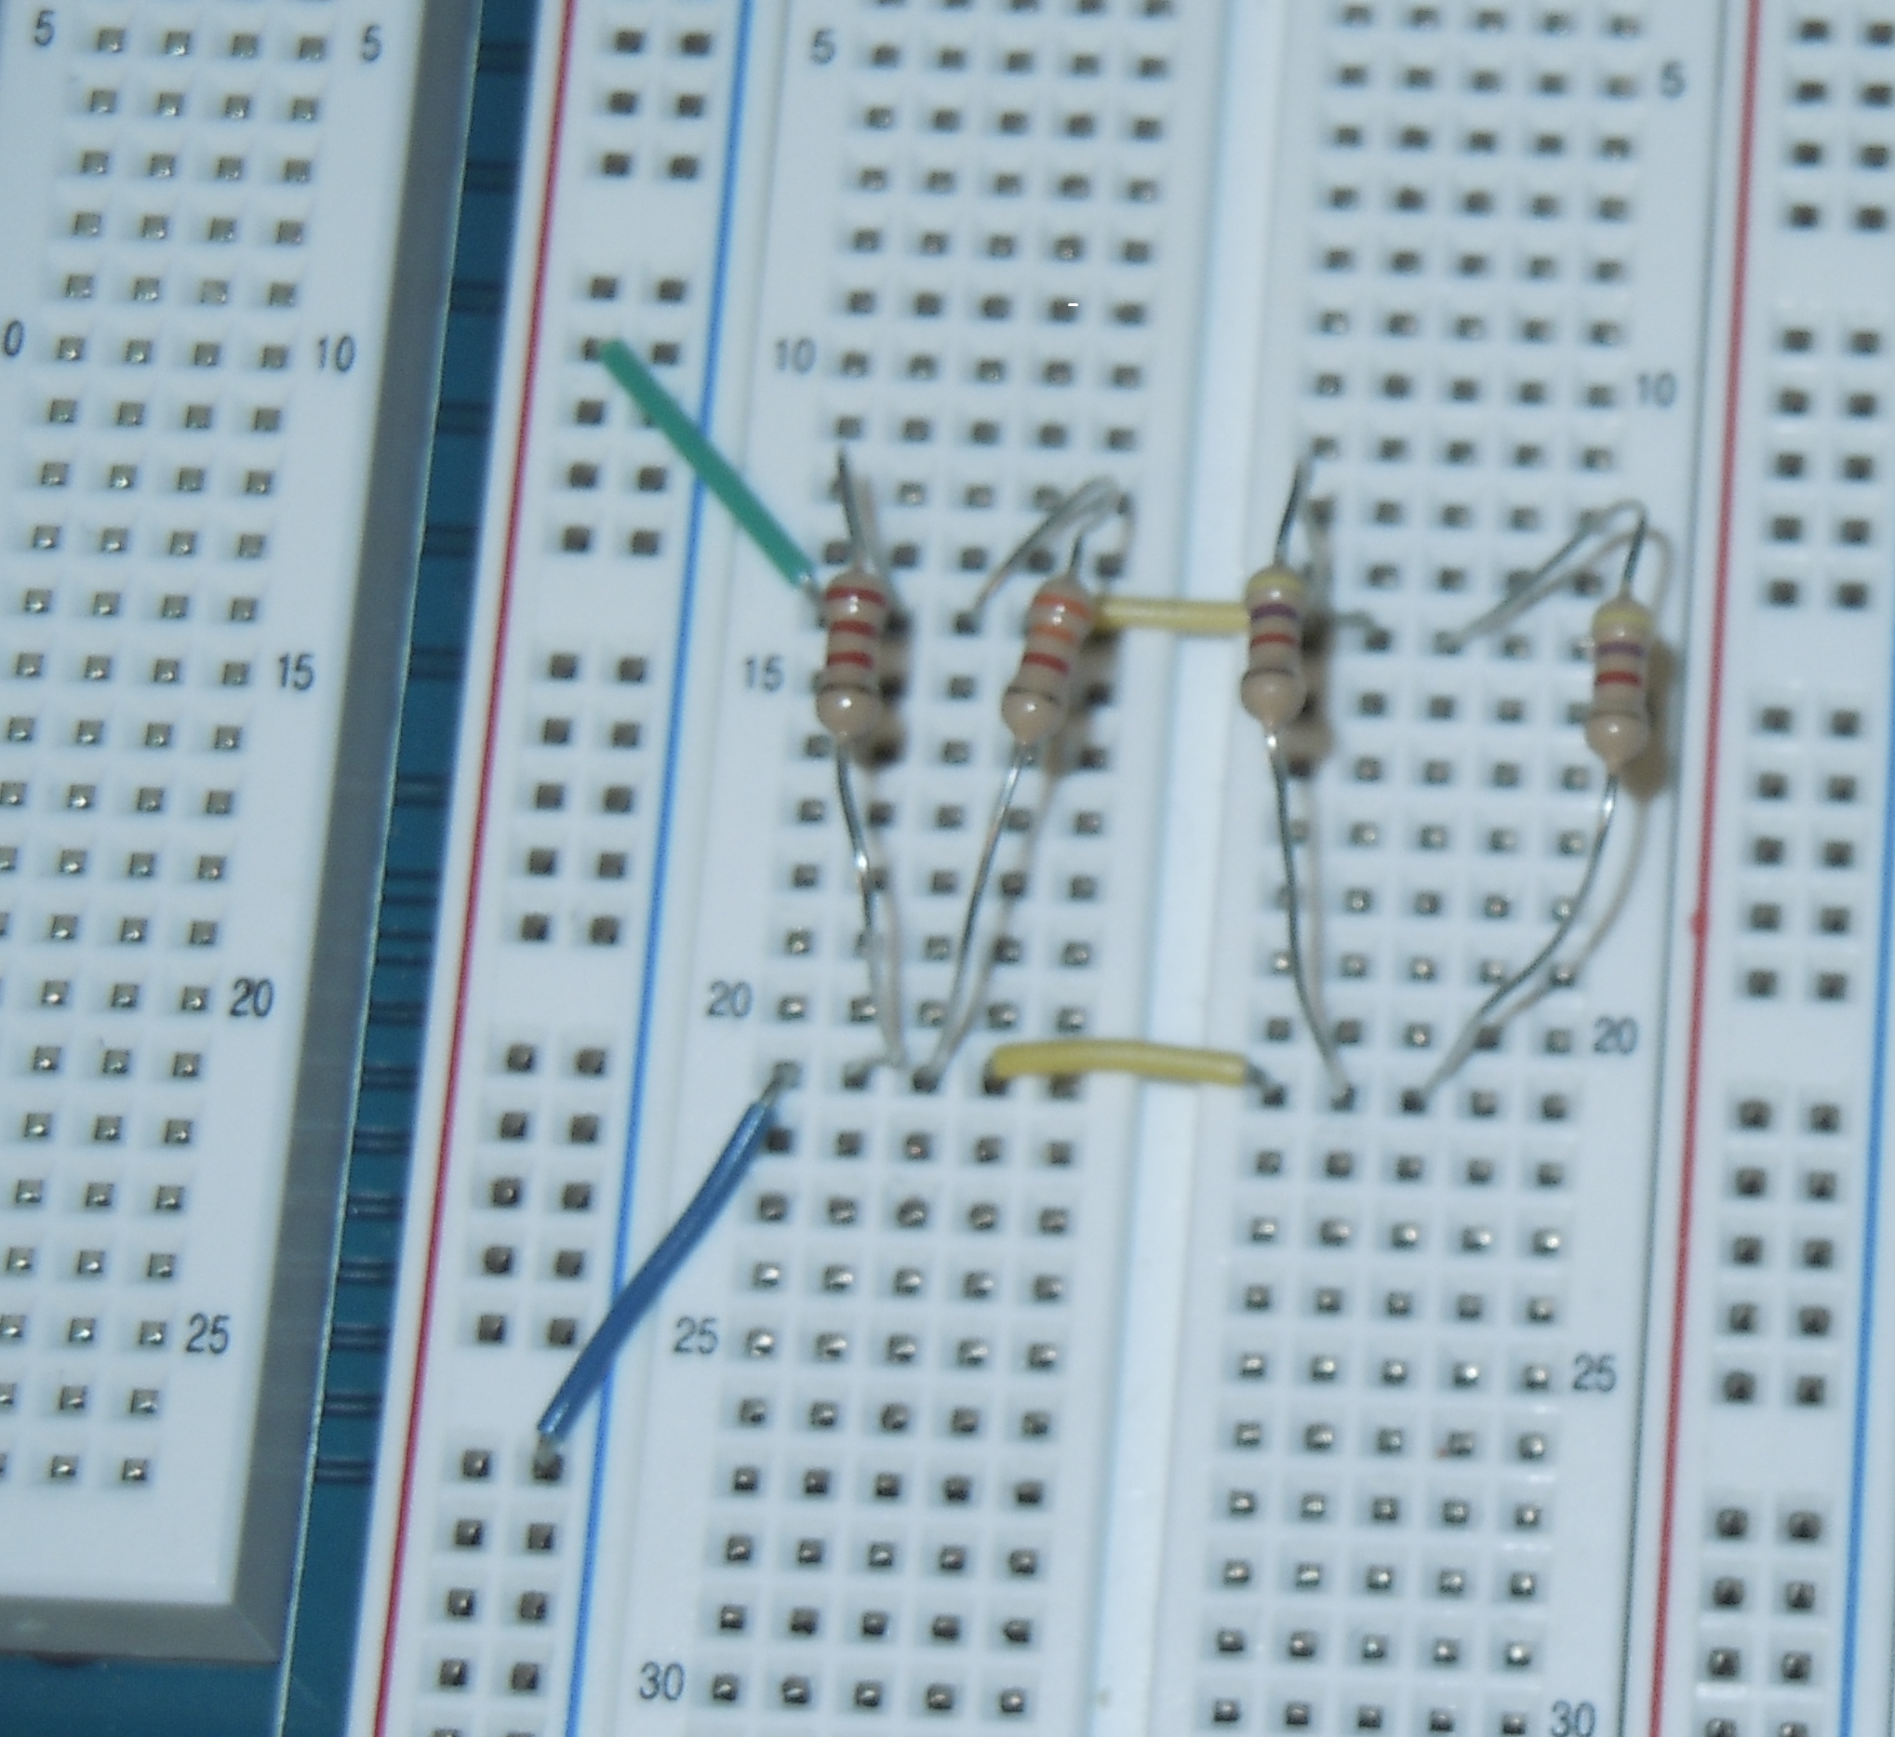
Lab 7 – Resistor Parallel Circuit
Calculations, Simulations, Measurements

Slide 28
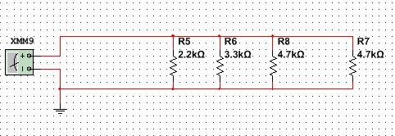
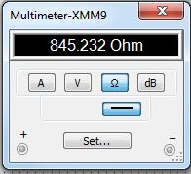
Lab 7
Simulations:
Total Resistance
R4
R1
R2
R3

Slide 29
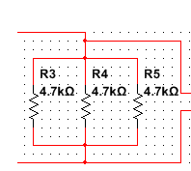
Lab 8 –Black Box Design, Equal Value Resistors

Slide 30
Lab 8 –Black Box Design, Equal Value Resistors
Purpose:
Learn about building a circuit that produces exactly 1.3V.
Equipment used:
Digital Multimeter: Gwinstck GDM8245 CL860264
Elvis II
5 Standard Resistors
5K ohm pot

Slide 31
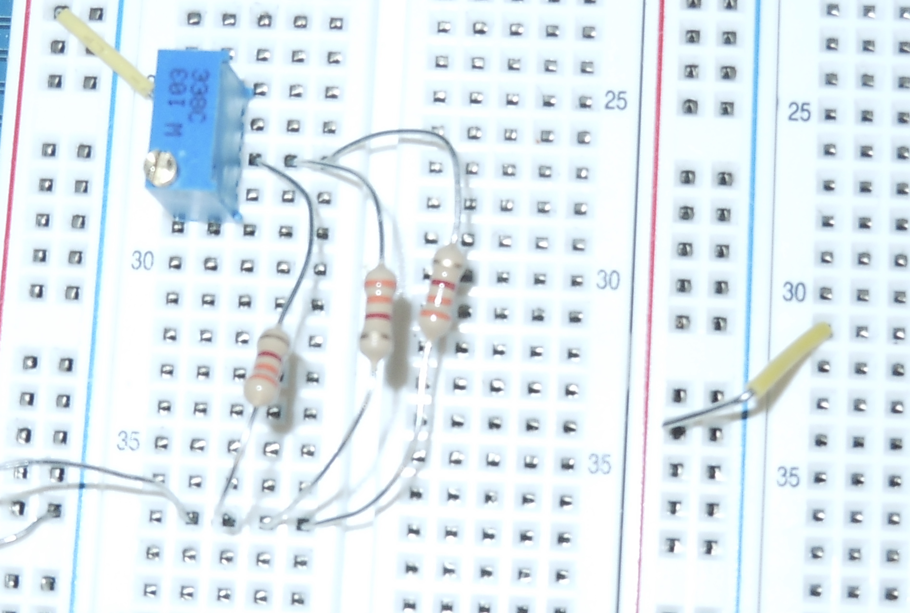
Lab 8 –Black Box Design, Equal Value Resistors
Calculations, Simulations, Measurements

Slide 32
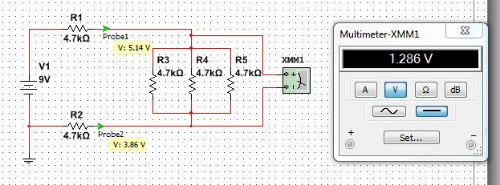
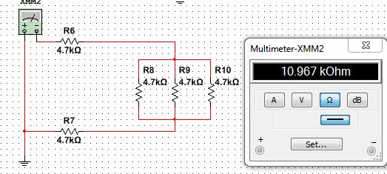
Lab 8
Simulations:
VA
VB
VA-VB
R1
Total Resistance
R3
R2
R4
R5

Slide 33
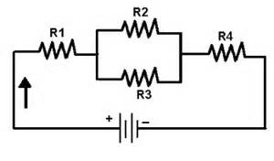
Lab 9 – Series/Parallel Resistors

Slide 34
Lab 9 – Series/Parallel Resistors
Purpose:
Experiment with series circuits and verify that the simulation, analysis (calculations) and test results all agree.
Equipment used:
Digital Multimeter: Gwinstck GDM8245 CL860264
Resistors

Slide 35
Lab 9 – Series/Parallel Resistors
Calculations, Simulations, Measurements

Slide 36
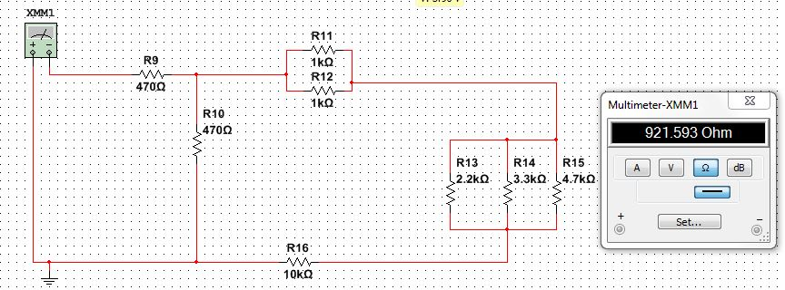

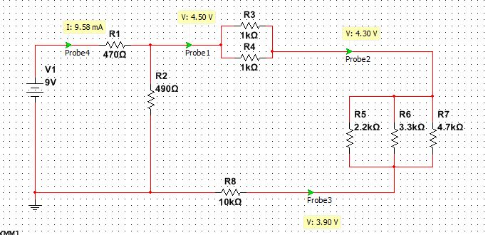
Lab 9
Simulations:
R1
Total Resistance
R2
R6
R4
R5
R7
R8
IT
VA
VB
VC

Slide 37
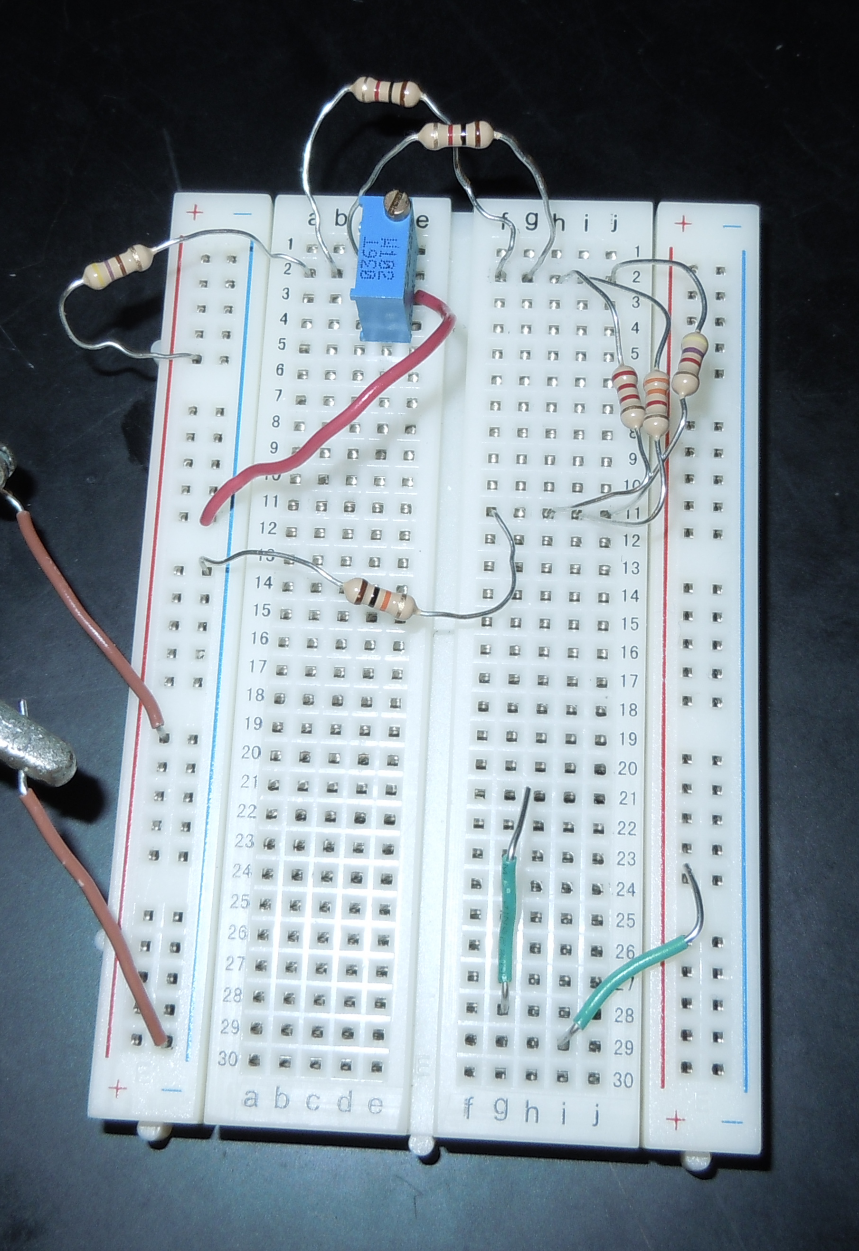
Lab 9 – Series/Parallel Resistors
Calculations, Simulations, Measurements

Slide 38
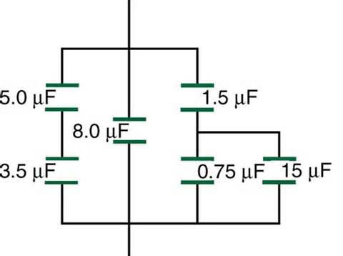
Lab 10 –Series/Parallel Capacitors

Slide 39
Lab 10 –Series/Parallel Capacitors
Purpose:
Experiment with series circuits and parallel combinations of capacitors.
Equipment used:
LCR Meter
3 Capacitors

Slide 40
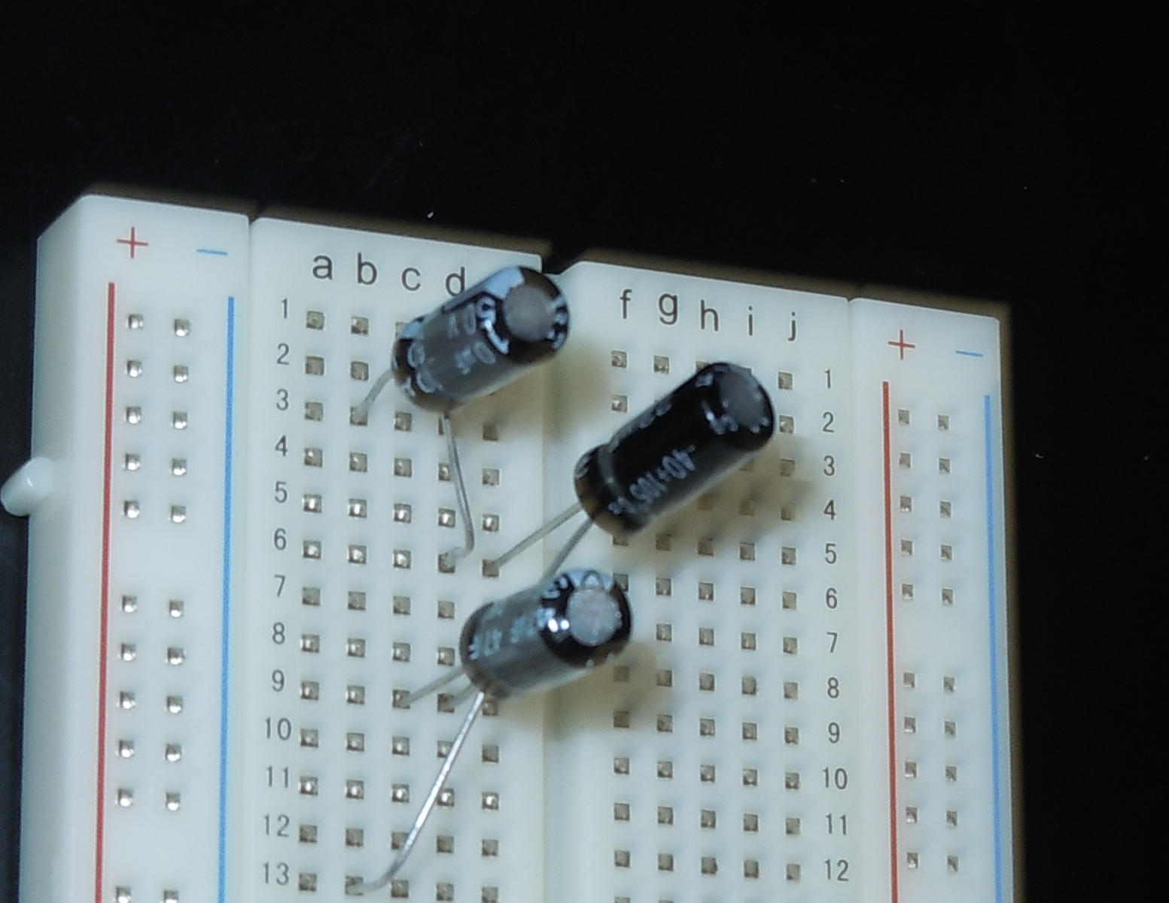
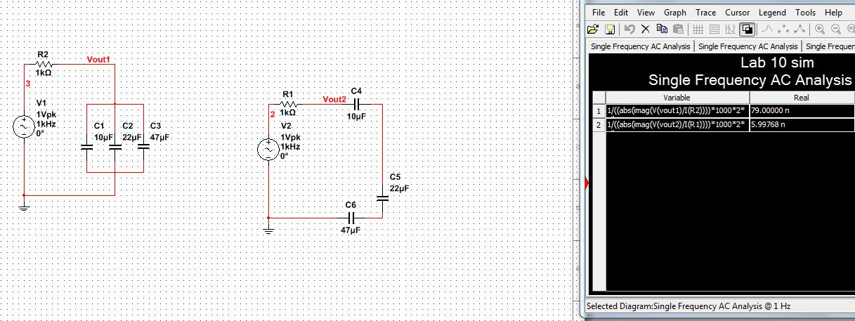
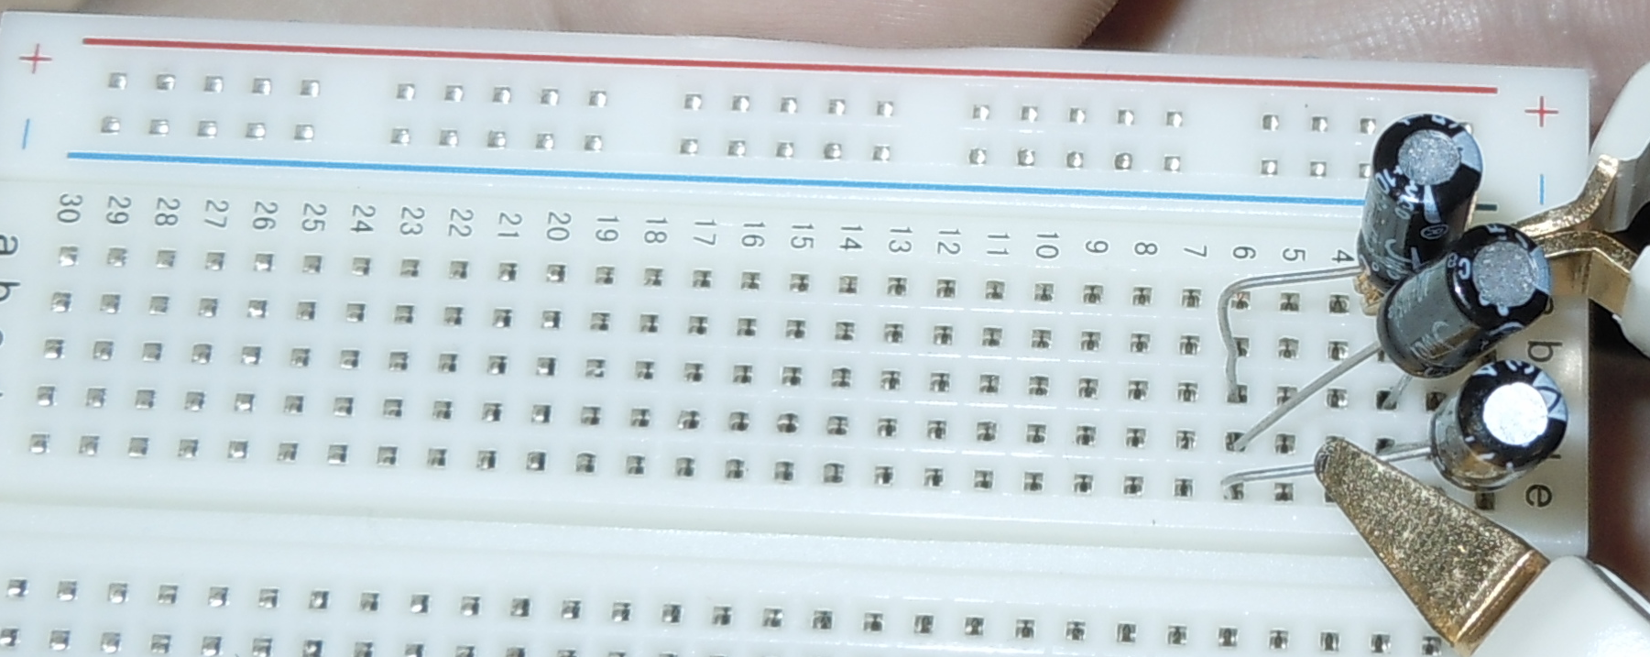
Lab 10 –Series/Parallel Capacitors
Calculations, Simulations, Measurements

Slide 41
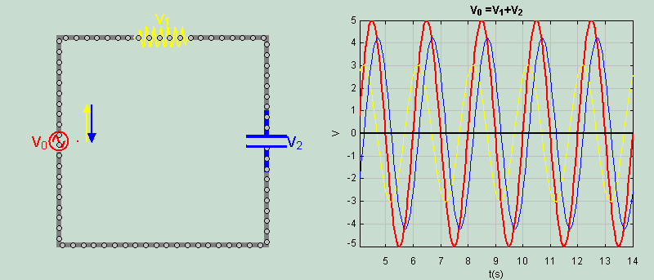
Lab 11 – RC Lab

Slide 42
Lab 11 – RC Lab
Purpose:
Experiment with RC (Resistor & Capacitor) circuits.
Equipment used:
Digital Multimeter
LCR Meter
Oscilloscope
Function Generator
3 Capacitors
1 Resistor

Slide 43
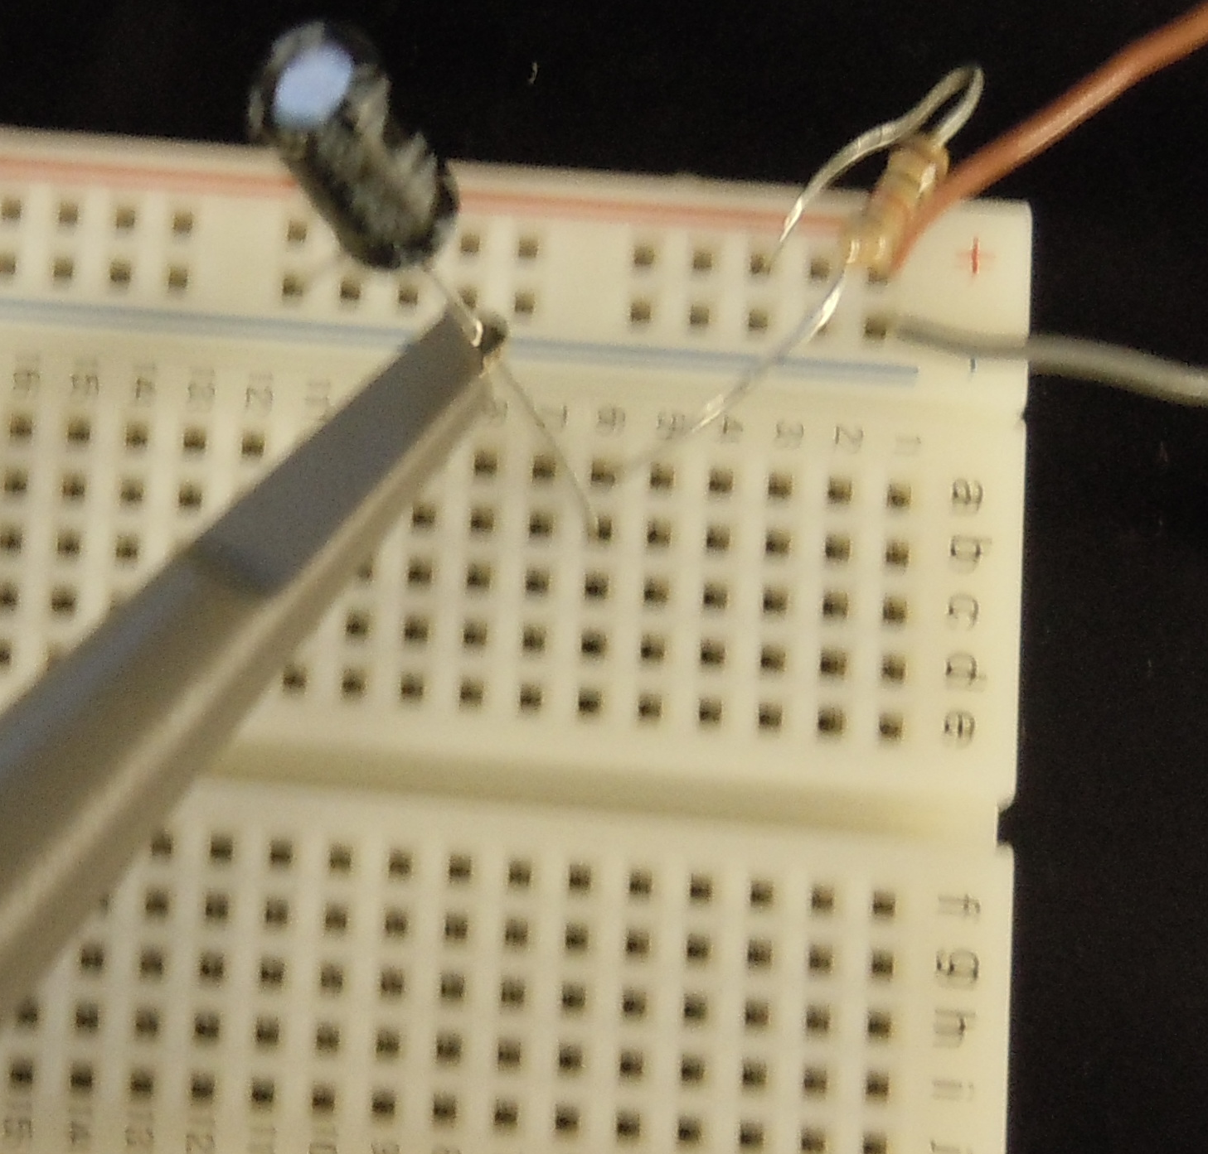
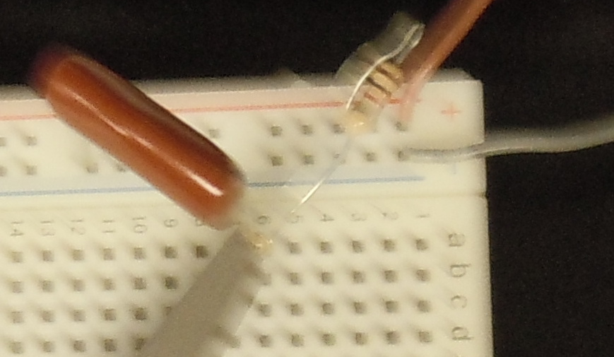
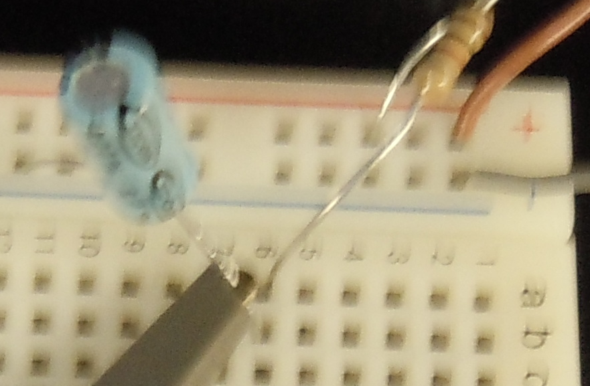
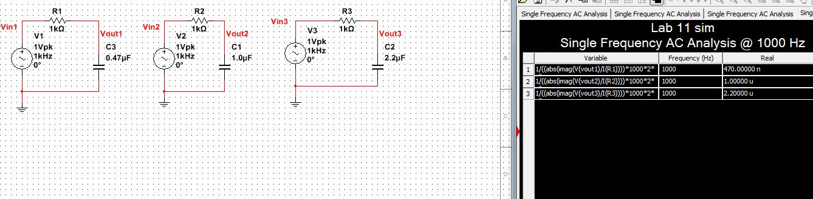
Lab 11 – RC Lab
Calculations, Simulations, Measurements

Slide 44
Lab 11 – RC Lab
Calculations, Simulations, Measurements

Slide 45
Lab 11 – RC Lab
Calculations, Simulations, Measurements

Slide 46
Lab 11 – RC Lab
Calculations, Simulations, Measurements

Slide 47
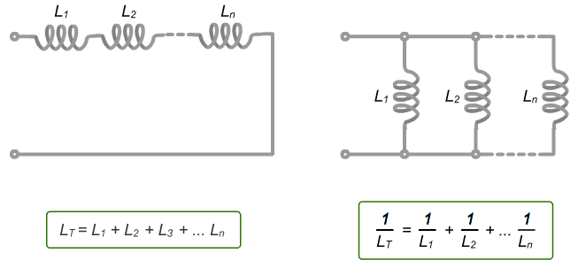
Lab 12 – Series/Parallel Inductors

Slide 48
Lab 12 – Series/Parallel Inductors
Purpose:
Experiment with series circuits and parallel combinations of inductors.
Equipment used:
LCR Meter
3 indoutors

Slide 49
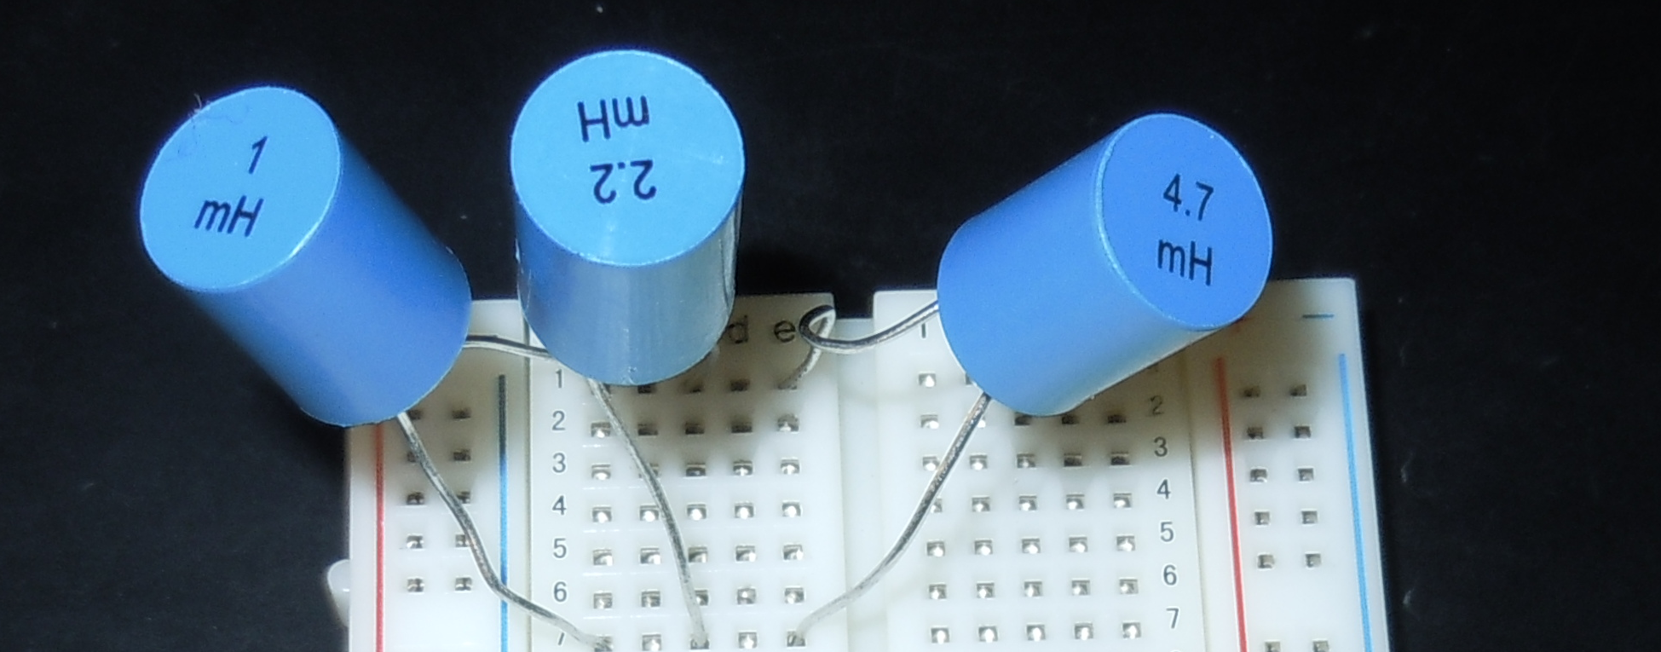
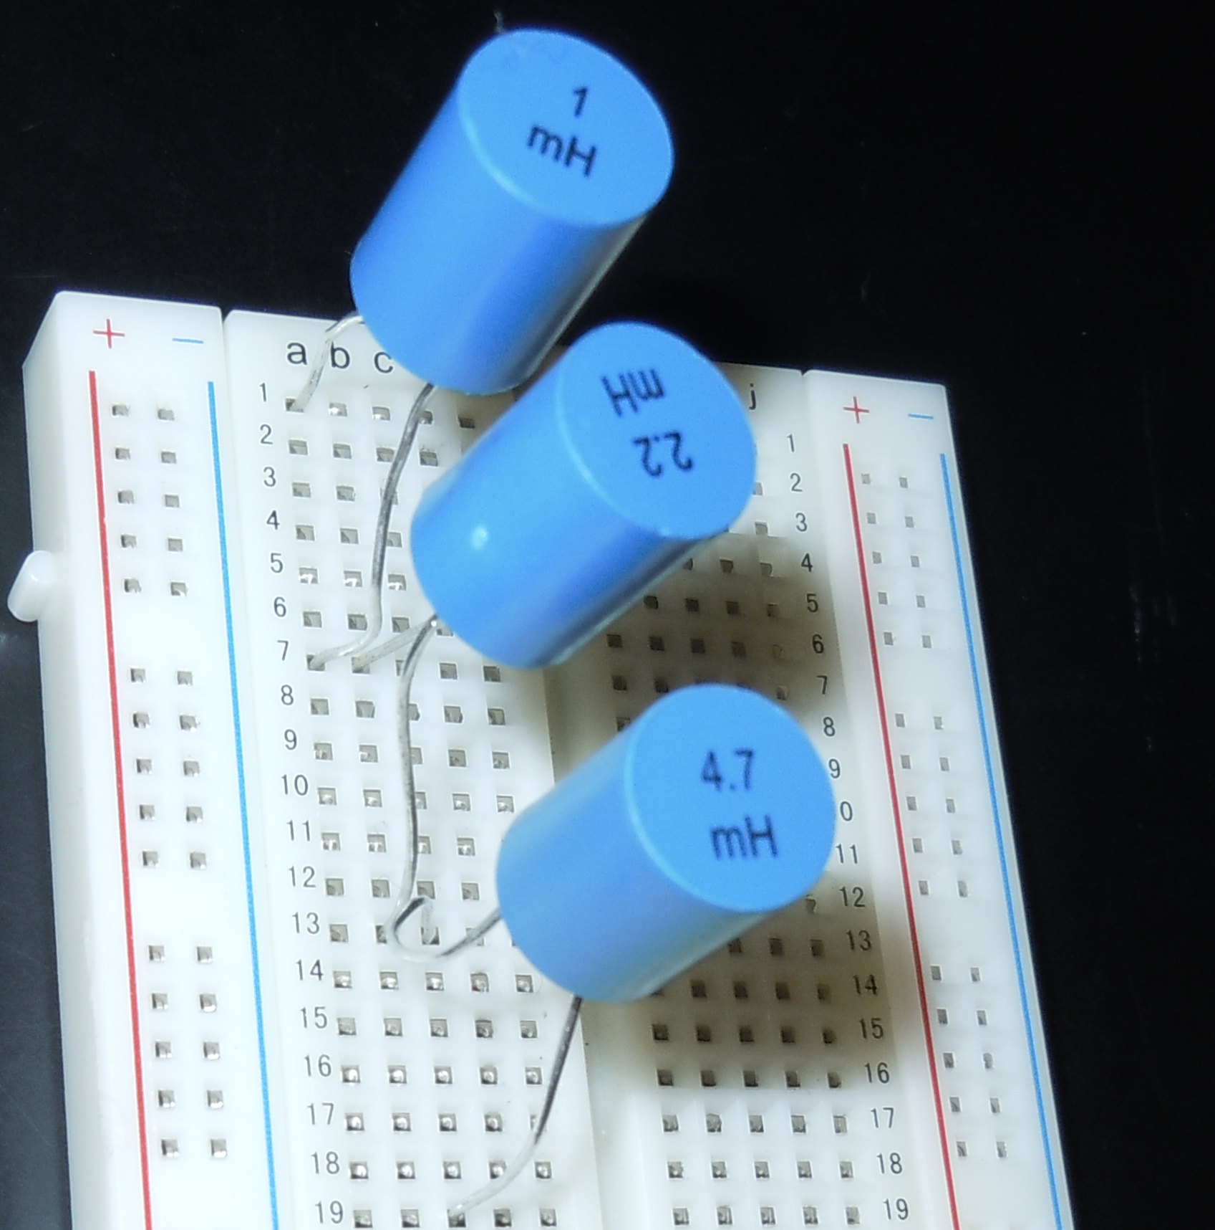
Lab 12 – Series/Parallel Inductors
Calculations, Simulations, Measurements

Slide 50
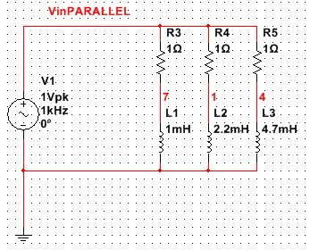
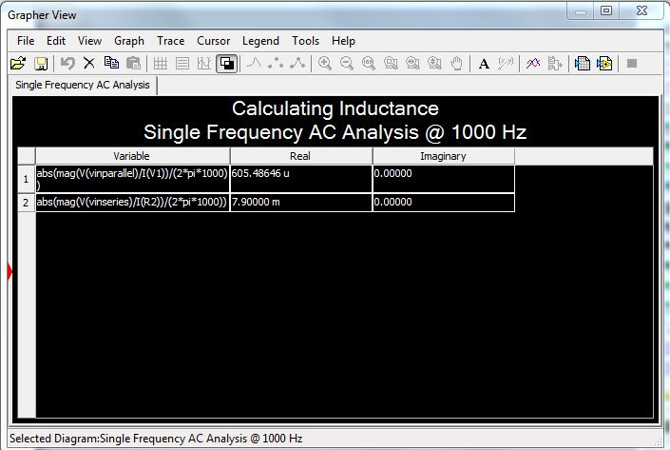
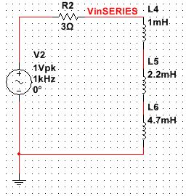
Lab 12
Simulations:

